Slide 1
Inventorying Intangible Cultural Heritage IMP 5.6
UNESCO
Intangible Cultural Heritage Section

Slide 2
In this presentation...
Why inventories are needed
What the Convention says about inventorying
Planning inventorying projects
Examples of inventorying processes

Slide 3
Why inventories
Assist in safeguarding
Assist in awareness raising
Build trust and communication
Required under the Convention

Slide 4
Identify with the participation of communities
Article 11b
Each State Party shall …
identify and define the ICH present in its territory,
with the participation of communities, groups and relevant non-governmental organizations.

Slide 5
With a view to safeguarding
Article 12
To ensure identification with a view to safeguarding,
each State Party shall draw up,
in a manner geared to its own situation,
one or more inventories
of the intangible cultural heritage present in its territory.

Slide 6
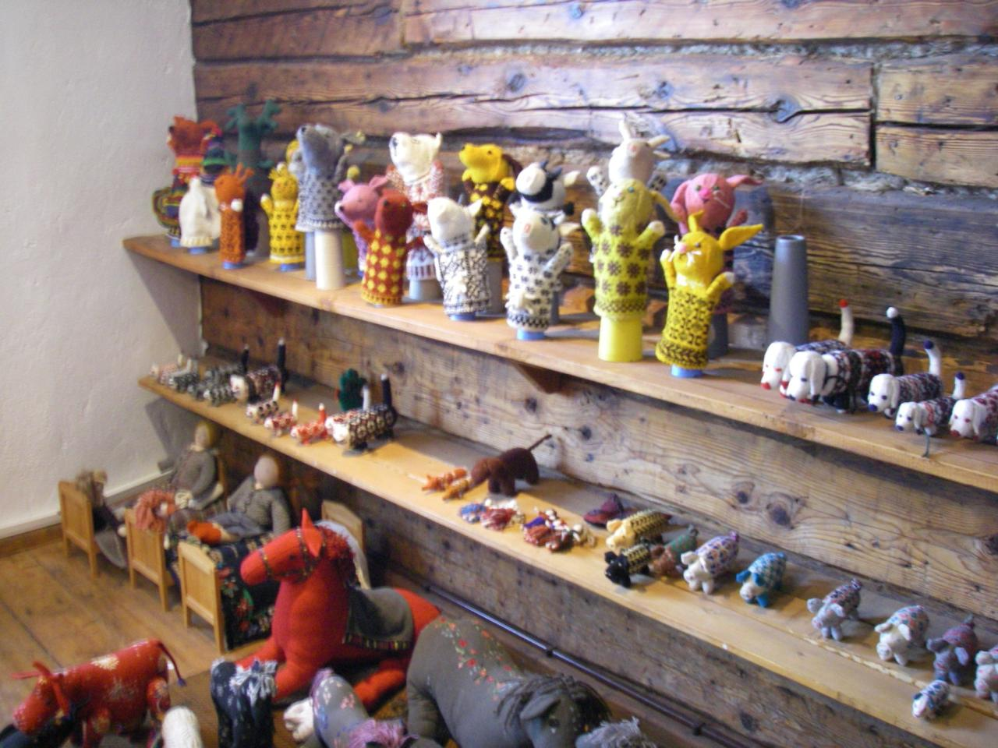
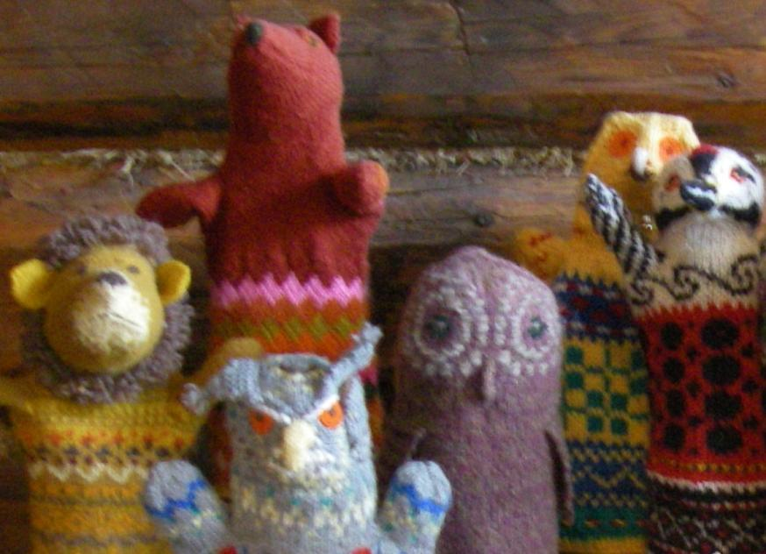
Case study: Estonian knitting and weaving
What to inventory,
What to safeguard?
Traditional knitted and woven products
Skills to create traditional products
Skills to use and develop traditional patterns (even in new products)
Soft toys made in Estonia using traditional patterns
Notes:
Photo (c) Harriet Deacon – full permission for UNESCO to use it

Slide 7
Access to the element
Article 13.d.ii
Each State Party shall endeavour to adopt (…) measures aimed at ensuring access to the ICH,
while respecting customary practices governing access to specific aspects of it

Slide 8
Example: The Australian Institute of Aboriginal and Torres Strait Islander Studies
Code of ethics for researchers
Enforces customary limitations on access to indigenous intangible heritage databases
Requires users to respect cultural sensitivities
Protocols allow indigenous control over access to sensitive items

Slide 9
Leeway and restrictions
Leeway
in a manner geared to its own situation.
Restrictions
identification and definition of the ICH present in its territory;
with communities, groups, NGOs;
with a view to safeguarding;
respecting customary practices governing access;
to be regularly updated.
to be reported about

Slide 10
Purposes and outcomes
Identifying & defining
Establishing viability
Identifying threats/risks (if any)
Building relationships for safeguarding
Awareness-raising
Reinforcing sense of identity and continuity of ICH bearers

Slide 11
From Inventories to Nominations
Criteria U.5 and R.5 requires elements to be “included in an inventory of the ICH present in the territory(ies) of the submitting State(s) Party(ies)”
Inventory concerned need not be completed
Proof of inclusion of the element on the inventory required

Slide 12
Planning inventorying projects: basic tasks
Determining purpose of the inventory
Identifying and involving the communities concerned and other stakeholders (including NGOs)
Finding resources to undertake the project
Identifying/creating structures for data collection and networking
Building consultative mechanisms and trust, obtaining consent
Data collection and data entry
Dissemination, access and updating

Slide 13
Designing inventorying projects: many questions
? ?
? ?
? ?
? ?
? ?
? ?
? ?
? ?
? ?

Slide 14
Advice from UNESCO?
No specific instructions in Convention or ODs
But Secretariat provides, on the website of the Convention:
Kit of the Convention, including a booklet on ‘Identifying & Inventorying ICH’;
Descriptions of inventorying exercises; and a
Model questionnaire for adaptation.

Slide 15
Examples of inventories
Canada
Uganda
Brazil
Estonia
Indonesia

Slide 16
Case Study: Newfoundland and Labrador (Canada)
Inventory making as part of provincial policies for safeguarding ICH
Coordinating structures appointed
Community participation
Community development as a major purpose
Cooperation between government, academia, NGOs and communities
Results available online

Slide 17
Case study: A community-based inventory project (Uganda)
12 Busoga community members trained to identify and inventory elements of intangible heritage in their own community
Information gathered will be included in the national ICH inventory for Uganda
Busoga Community practising their interviewing skills for inventorying the intangible heritage © Centre for Performing Arts and Culture
Notes:
http://www.unesco-nairobi.org/index.php?option=com_content&view=article&id=118:intangible-cultural-heritage-uganda&catid=99:uganda&Itemid=144

Slide 18
Case study: Many inventories and a Registry (Brazil)
Institutional and legal infrastructure for ICH research and inventorying since the 1950s
Numerous inventories, a National Inventory and a Registry
Strong emphasis on community participation and consent

Slide 19
Case study: A national inventory (Indonesia)
Grew out of a cultural mapping project from the 1990s
Use of government employees across the country to collect data
Online data checking by experts
Centralized data storage and management

Slide 20
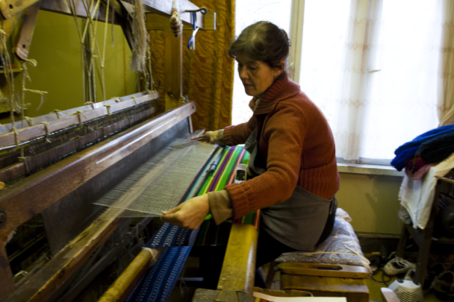
Case study: A community-driven inventory (Estonia)
Community members with specialist skills manage inventory project after initial consultations with national working group
Community organizations and schools get involved
ICH database managed by a central state agency for ICH
Kartin Lember weaving traditional skirt fabric on Hiiumaa (c) Helgi Pollo
Notes:
Kartin Lember weaving traditional skirt fabric on Hiiumaa (c) Helgi Pollo 2010
Permission from Helgi pollo for use of the picture

